Slide 1
SOIL CLASSIFICATION CHALLENGE

Slide 2
PART 1
The Soil Image Classification Challenge is a machine learning competition organized by Annam.ai at IIT Ropar, serving as an initial task for shortlisted hackathon participants.
Competitors will build models to classify each soil image into one of four categories: Alluvial soil, Black soil, Clay soil, or Red soil.

Slide 3
Models
Pretrained Models with custom heads have been used with 5-fold cross validation and image size of 512
Models used are
resnext50_32x4d
EfficientnetB3
EfficientnetB5
EfficientnetB7
Vision Transformer Patch 16 384

Slide 4
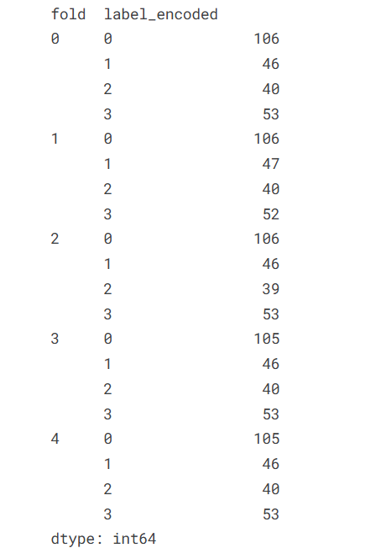
5 folds

Slide 5
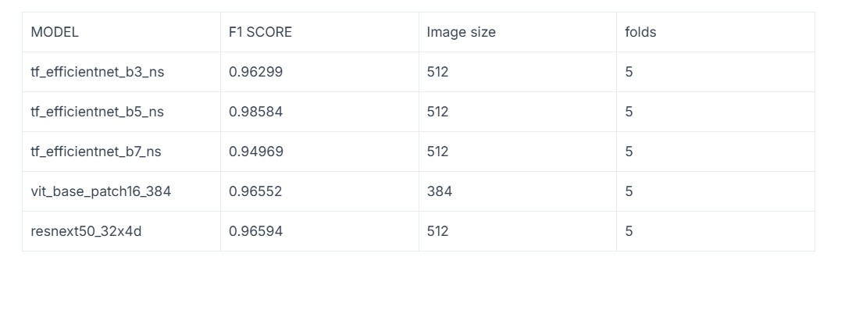
5 fold cross validation scores

Slide 6
PART 2
The Soil Image Classification Challenge is a machine learning competition organized by Annam.ai at IIT Ropar, serving as an initial task for shortlisted hackathon participants.
Competitors will build models to classify the images to if they're soil image or not.

Slide 7
Models used
We follow a autoencoder architecture to train the images
The anomalies are detected using the reconstruction error
Top 5% are counted as anomalies
Backbone used
EfficientnetB0 , EfficientnetB1 ,EfficientnetB3 , EfficientnetB5
Simple Auto Encoder

